Slide 1
Hong Kong Observation Wheel
& AIA Vitality Park
Event Space

Slide 2
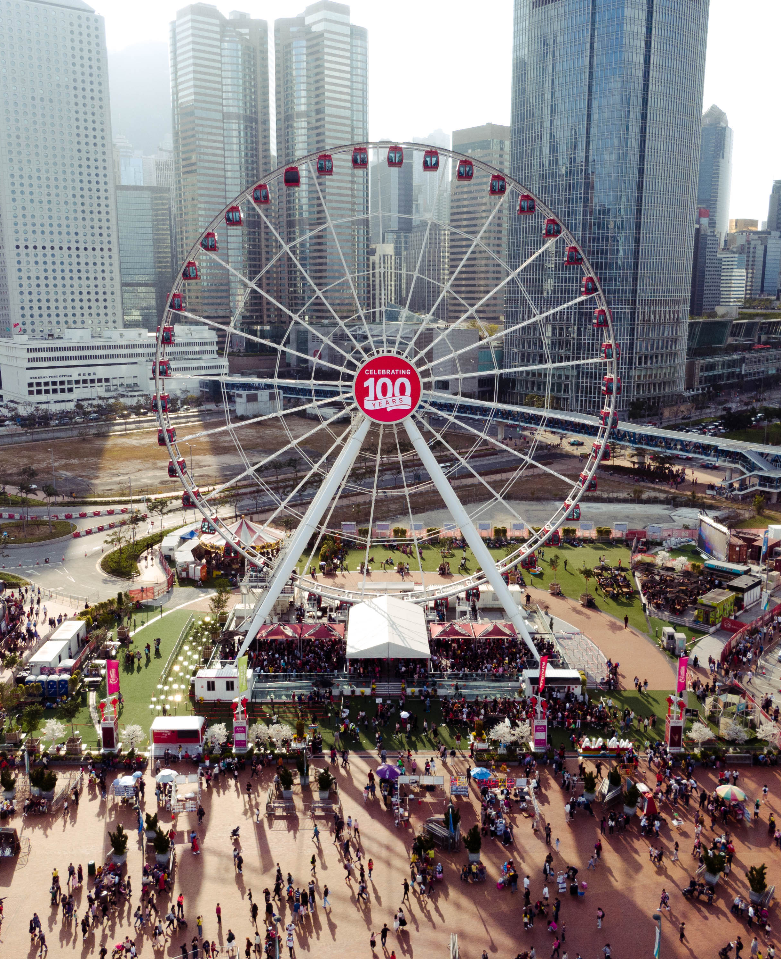
Visitor Numbers
3,500,000+
Attendance since opening
9,476
Average weekend daily attendance
4,526
Average weekday daily attendance
83%
of our visitors are from Hong Kong
Ages 30-34 or under 14
Median demograph

Slide 3
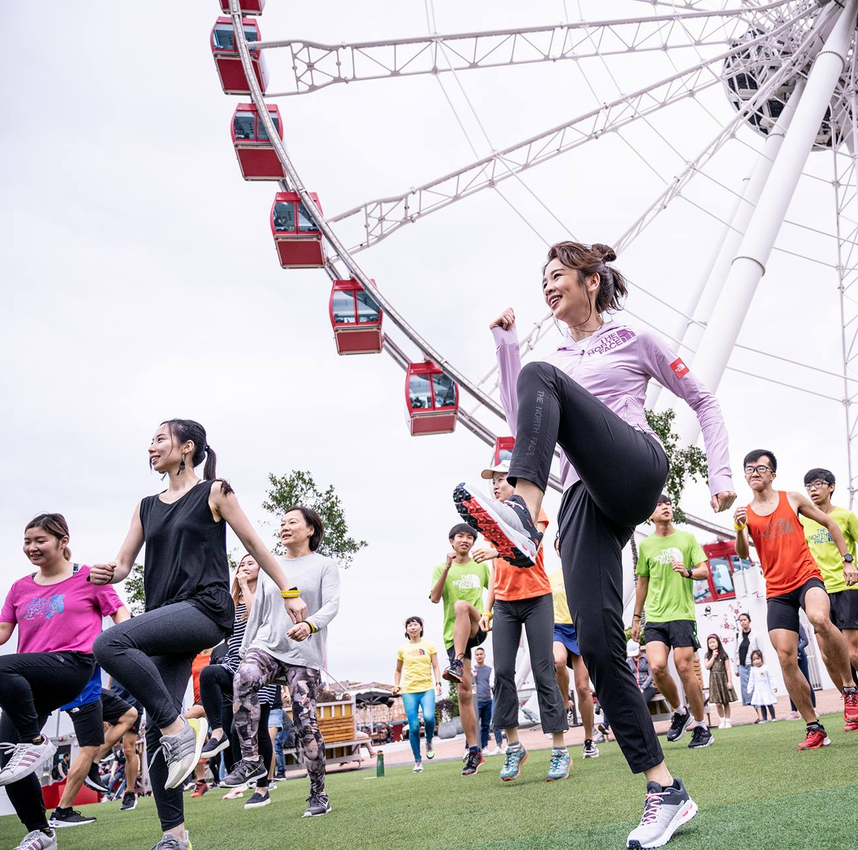
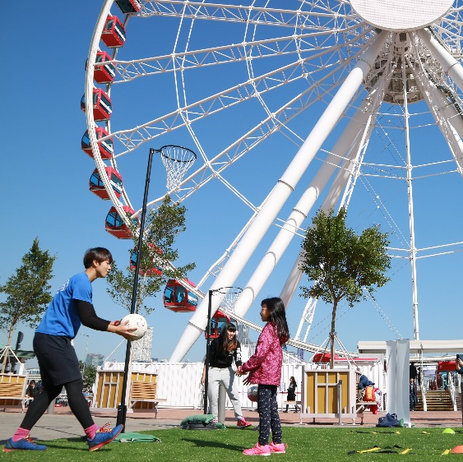
Our Key Values
Family & Friendships
Health & Fitness
Heritage & Community
Arts &
Entertainment
Ever Evolving
To celebrate the continual evolution and promotion of the above key values; the Hong Kong Observation Wheel and AIA Vitality Park hosts an eclectic mix of events, sports activities and workshops:
Click here to see our events showreel

Slide 4
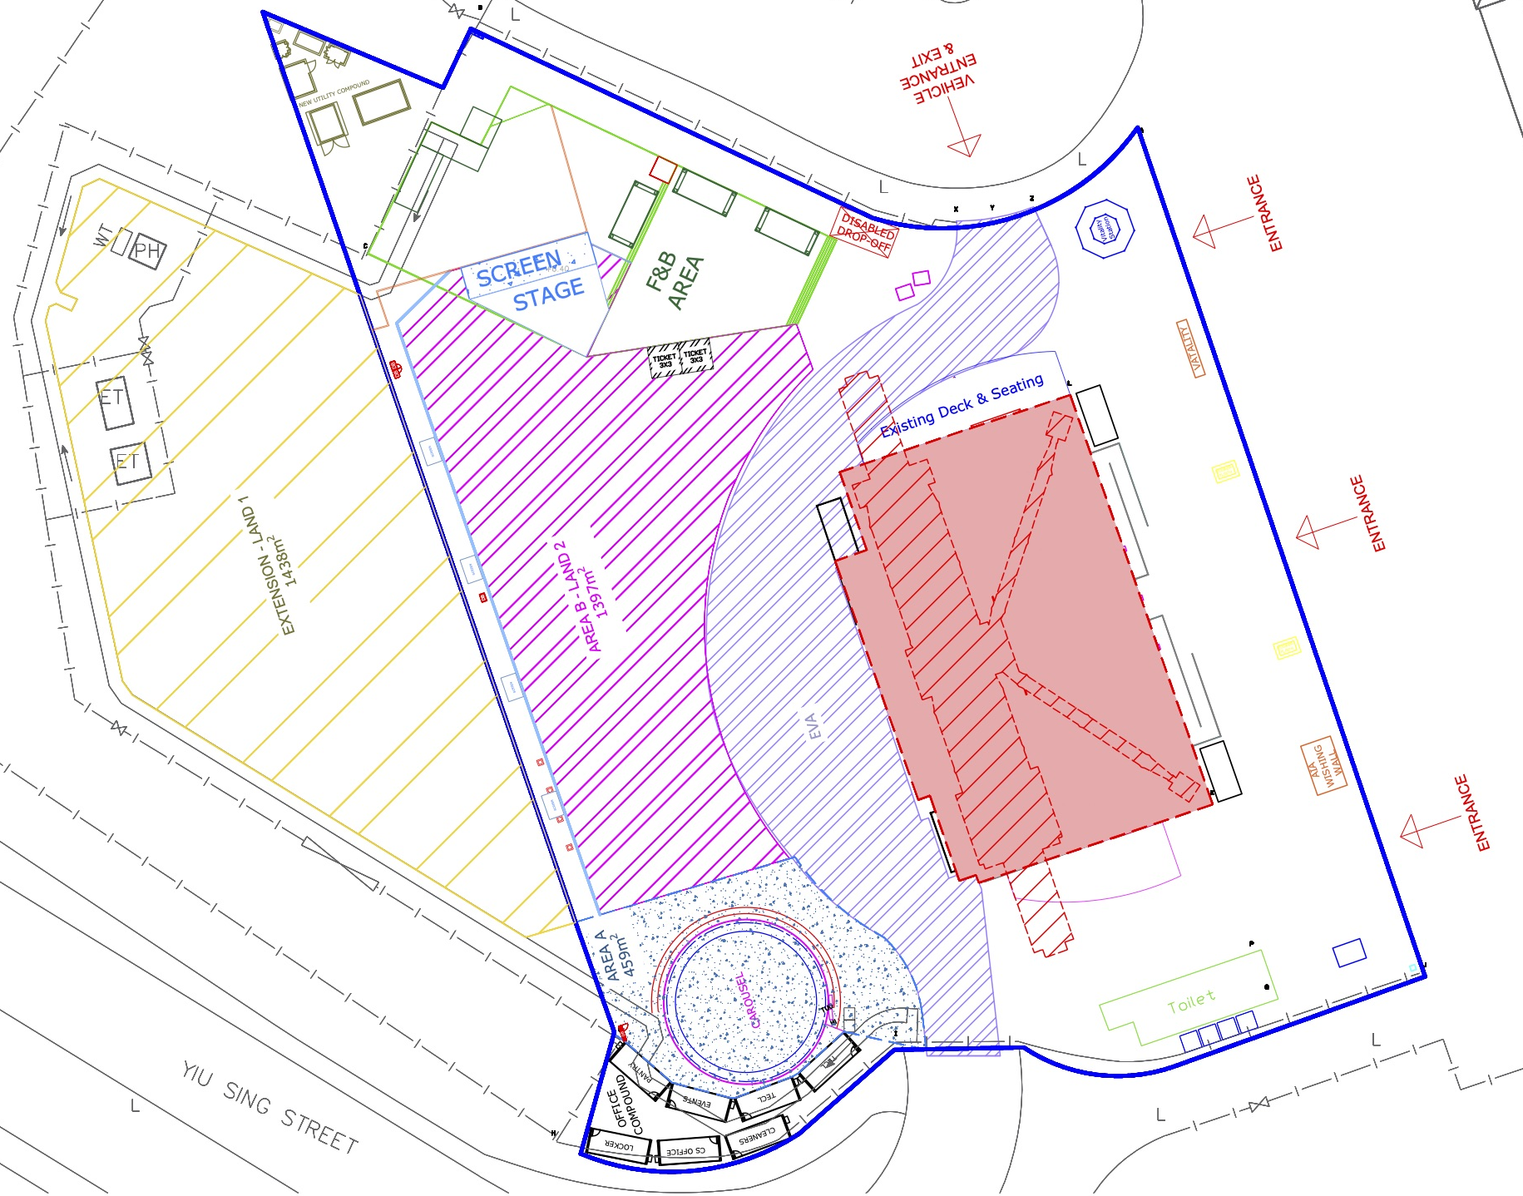
Event Space Site Map
Event Space AREA B Size:
approx. 1397sqm

Slide 5
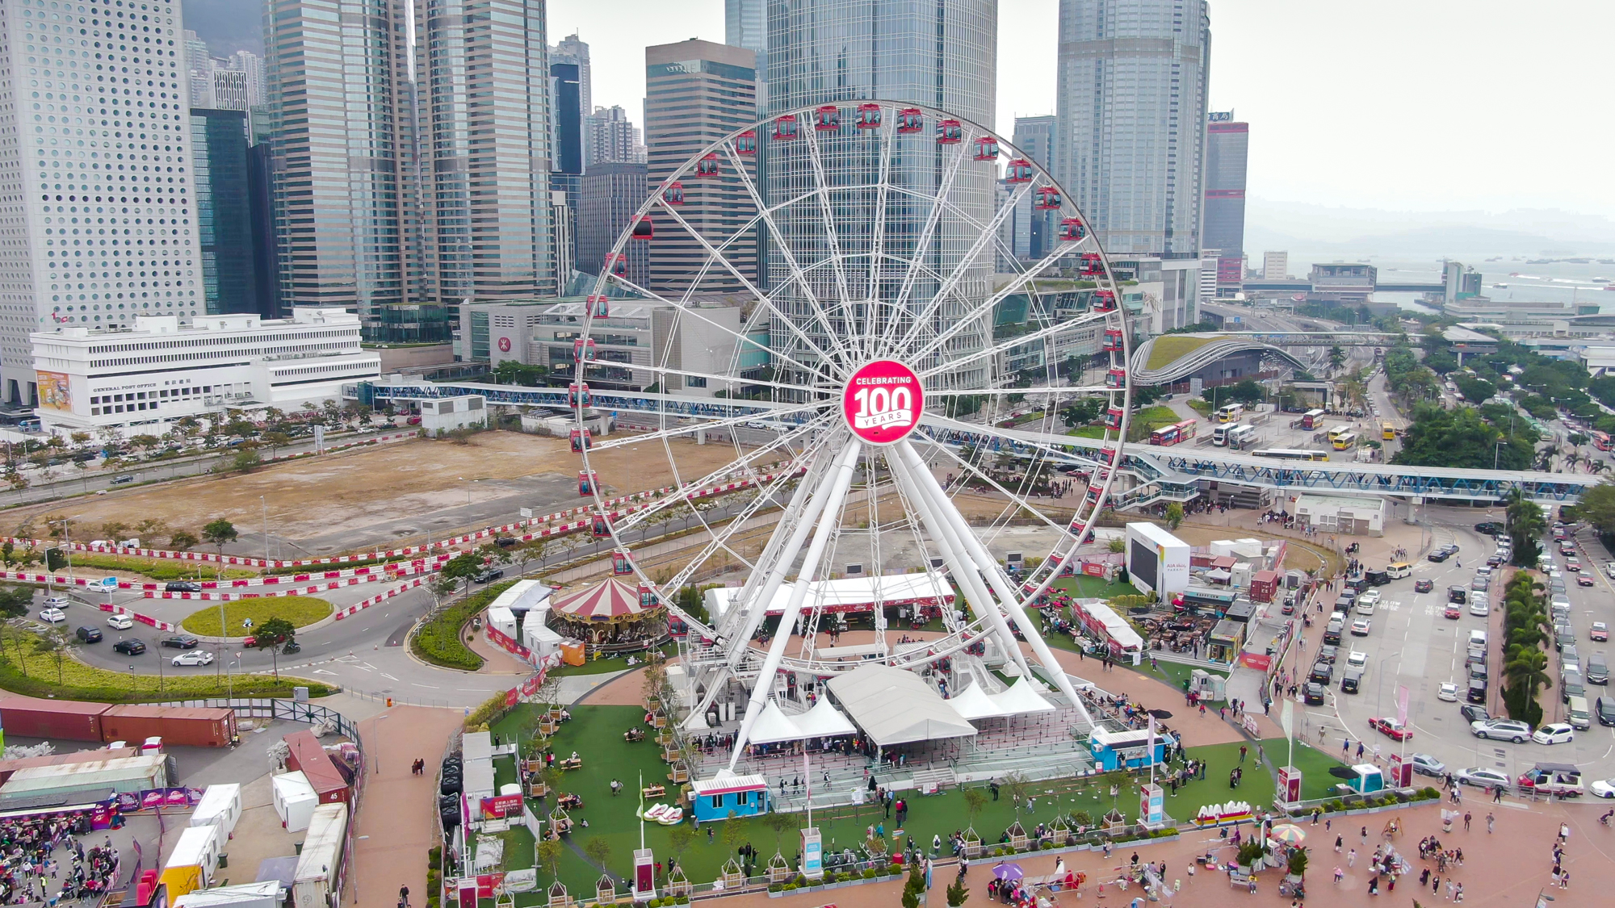
Event Space Aerial Shot

Slide 6
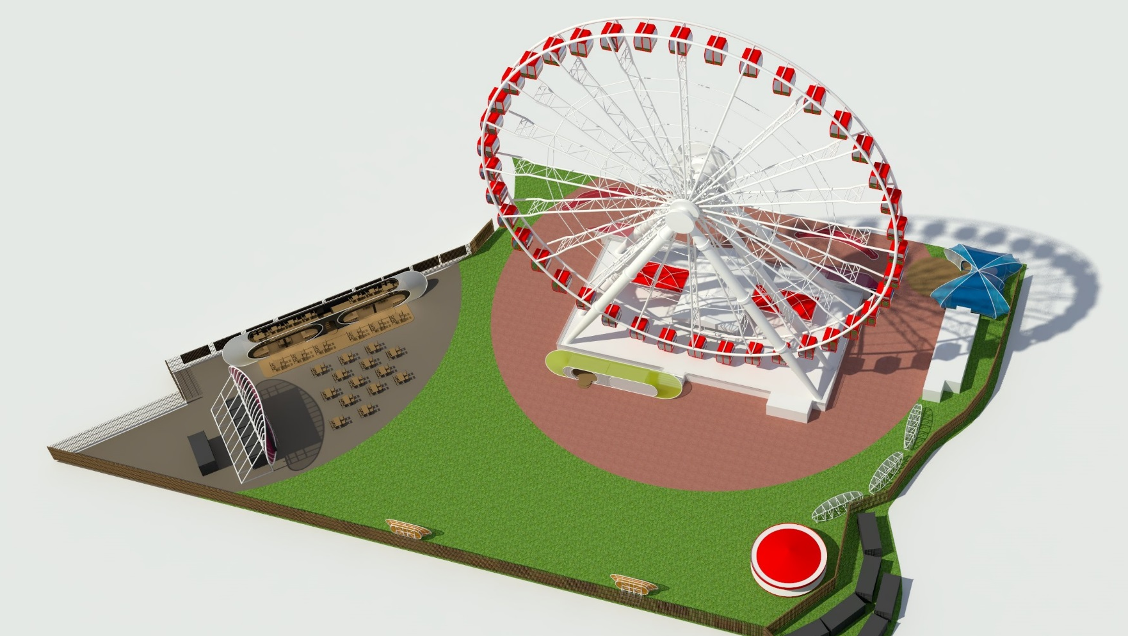
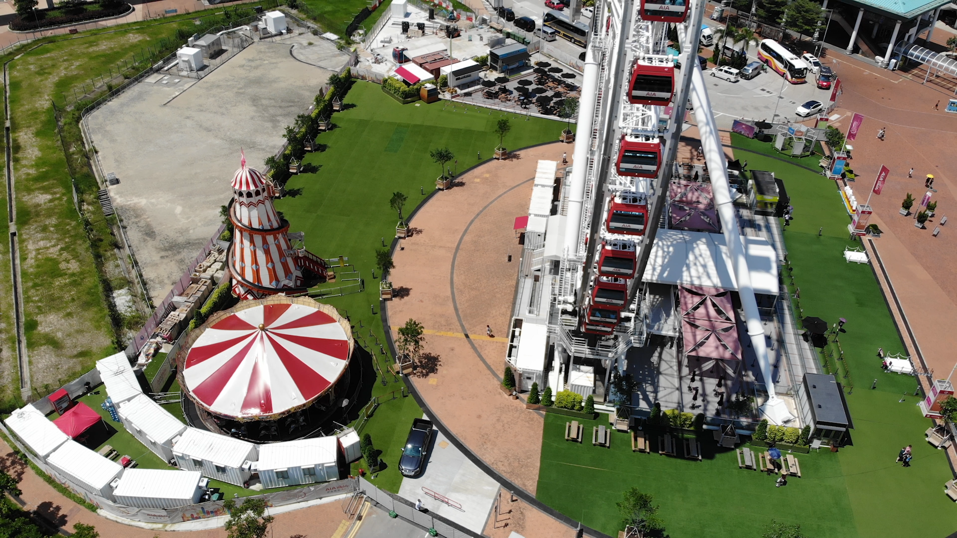

Slide 7
Event Space Facilities
Features available include:
5x HD LED Screens (1m x 2m) for promotional purposes
Large HD LED Screen (10m x 5m) for use
Designed as a ‘garden’ in the city scape
Branding and promotional areas on-site
Site attracts thousands of daily visitors
Astroturf flooring ready to use event space with on-site facilities
Security perimeter & interior fencing
Fresh water supply available
Power supply (300amp)

Slide 8
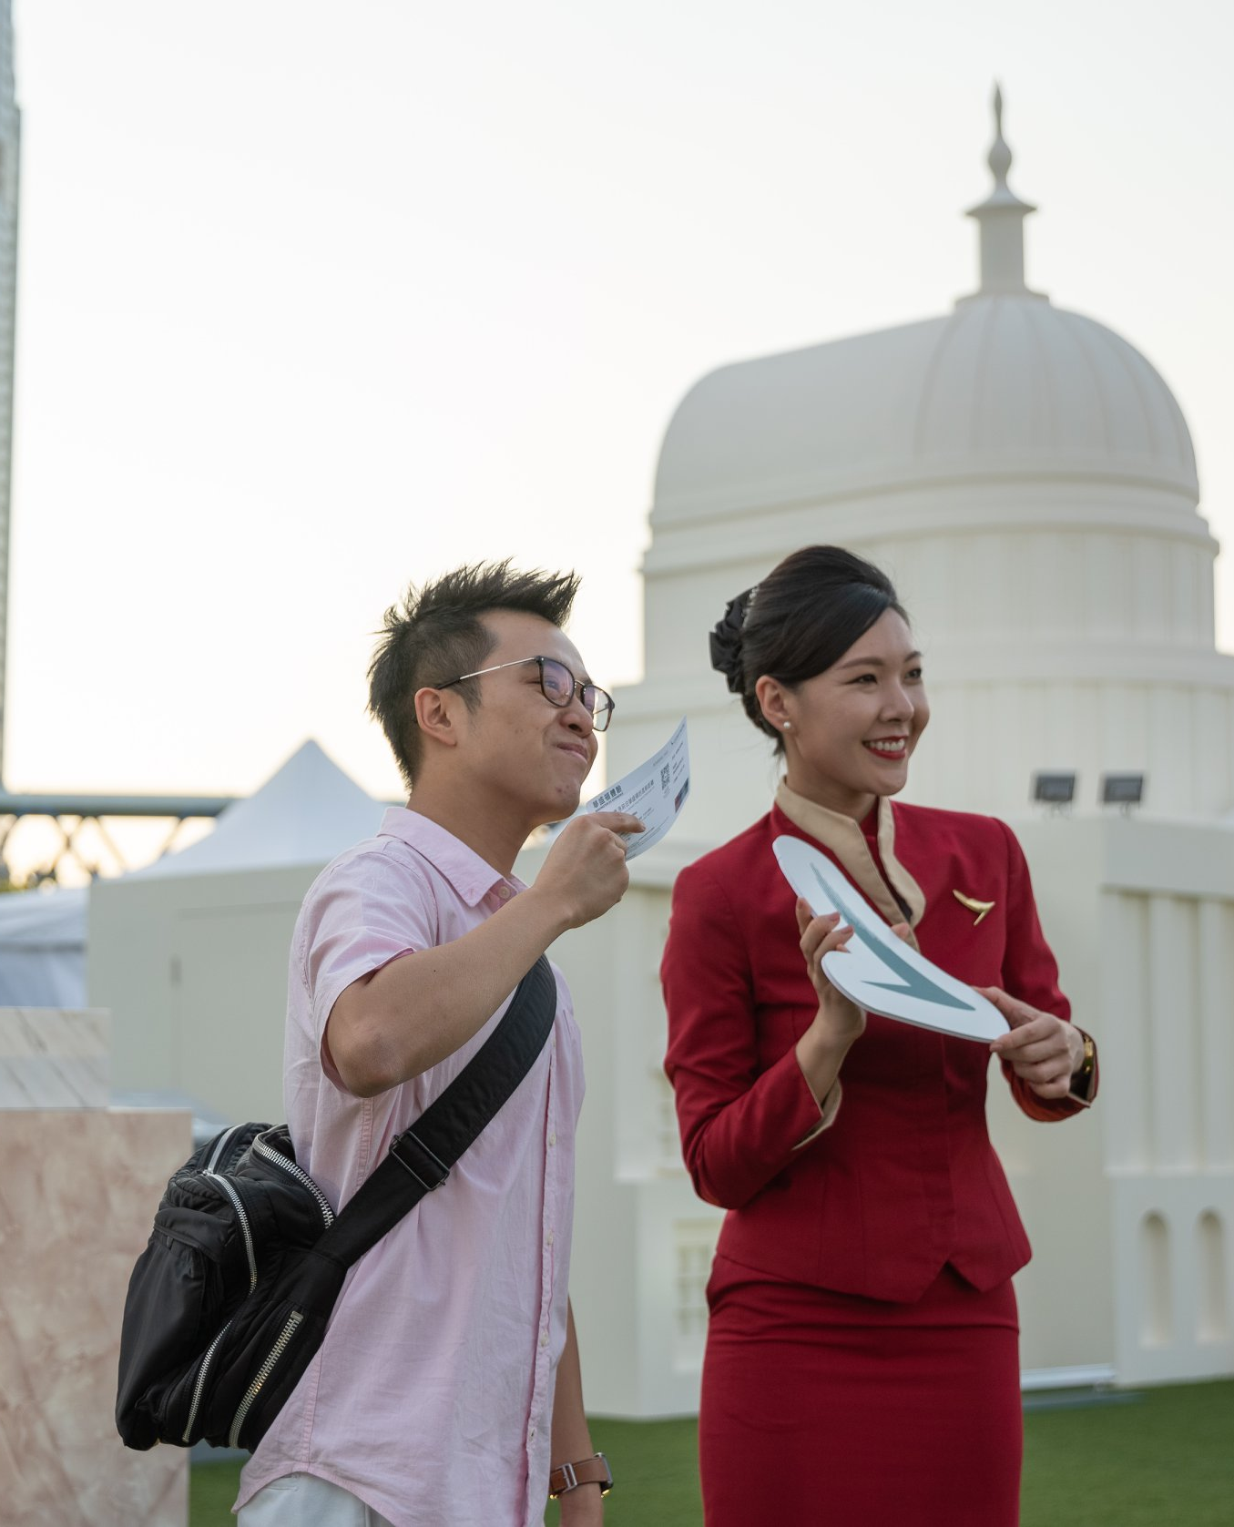
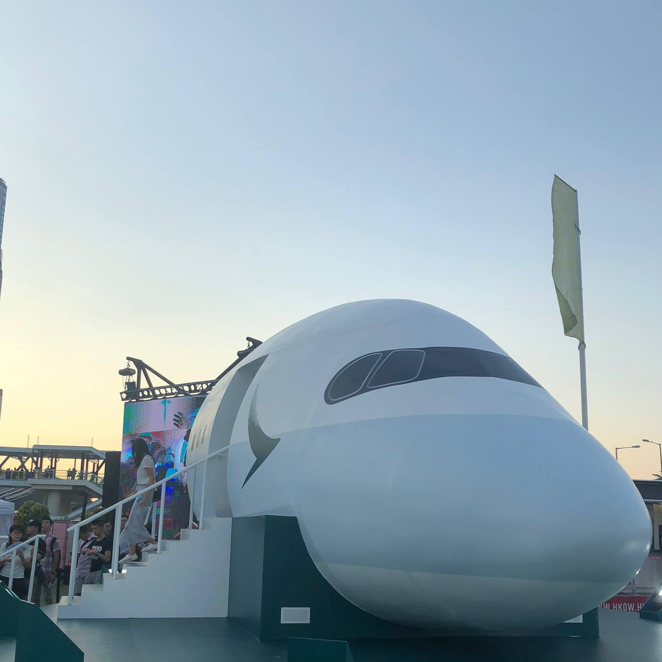
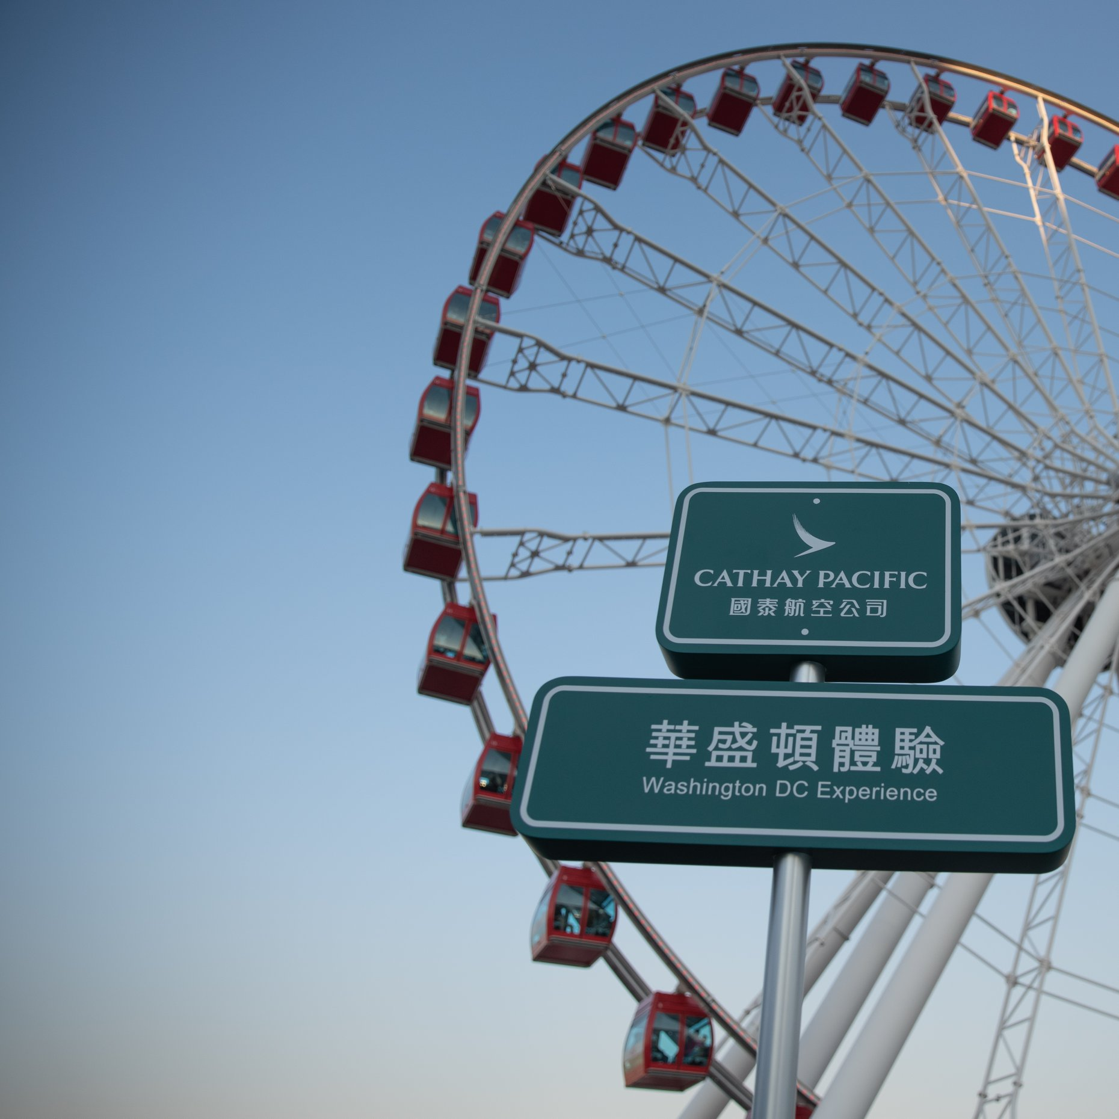
Cathay Pacific
Event Case Study
Objective
Build awareness for CX’s new route launch – Washington, DC.
Introduce the new aircraft A350-1000, especially Economy Class, to the mass.
Incorporate the interactive virtual reality which showcase the latest A350-1000 cabin and snapshots of Washington, DC
Activation
Virtual Reality Room
Participants were able to experience the new A350-1000 in VR while experiencing Cathay’s enhanced economy seat in a cabin simulator. Participants will exit the plane after playing with our VR game and land on the Washington DC street.
Photo Opportunity
Visitors were encouraged to take photos with the A350 plane and the Washington, DC landmarks and upload to Instagram using designated hashtags. Participants who uploaded their photos with with the event hashtags were rewarded with a small souvenir.

Slide 9
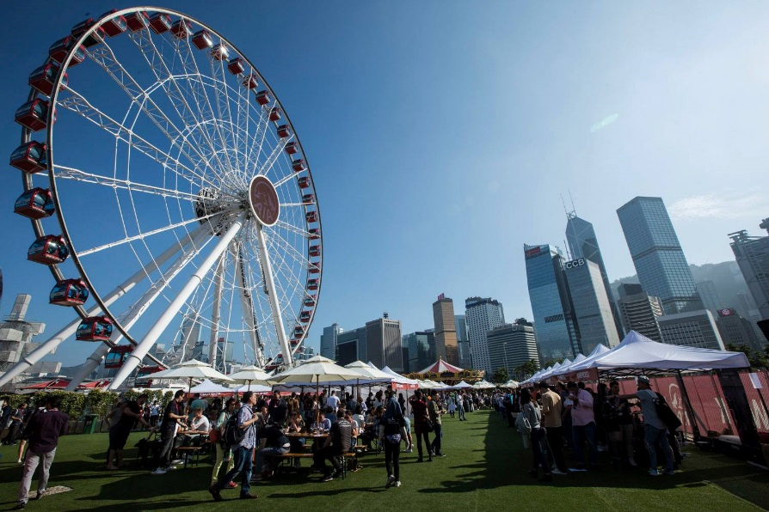
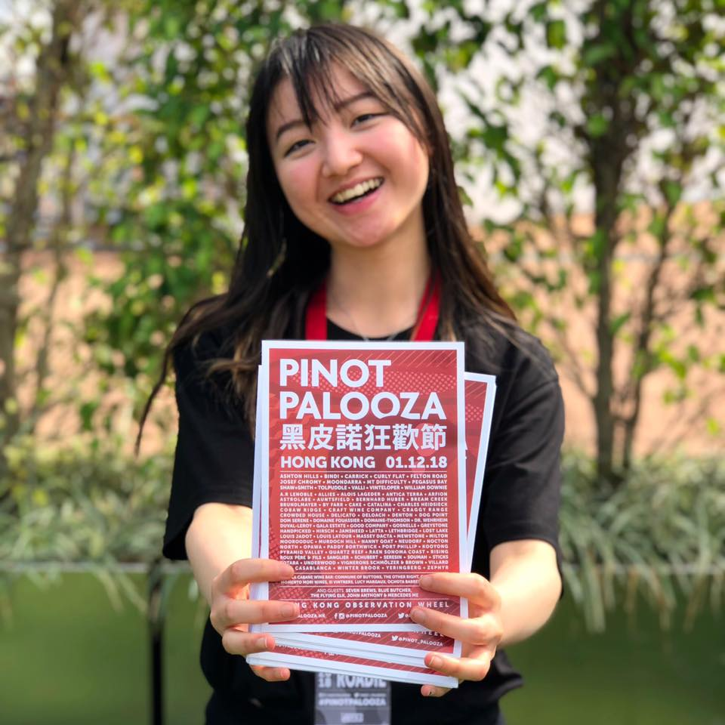
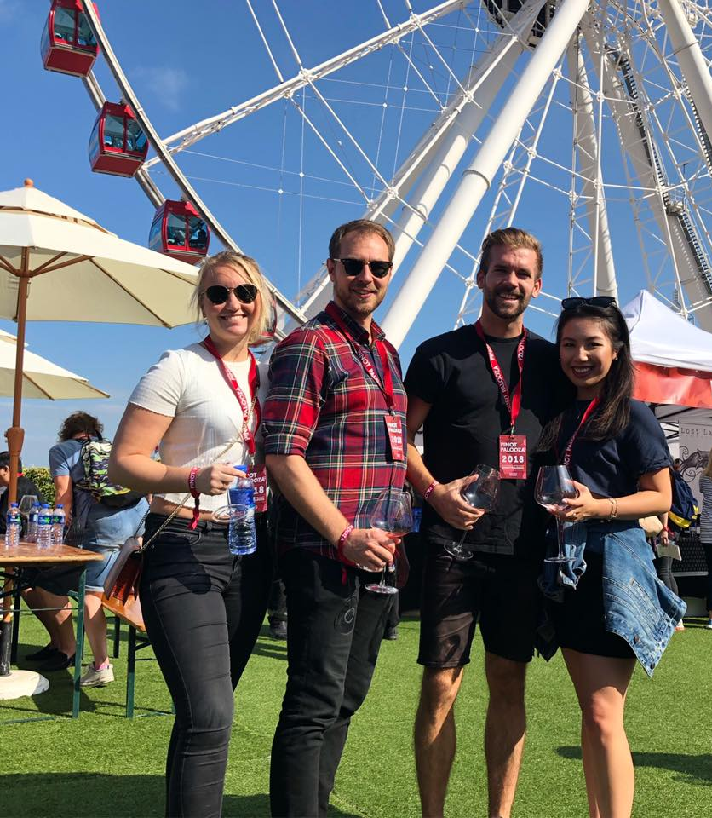
Pinot Palooza
Event Case Study
Event Type: Wine Tasting event
No. of Days: 1 day
Attendees: 1,200
Objective
To create a high-end lifestyle wine tasting event
Bringing fine Australian wines to Hong Kong in a unique ‘garden in the city’ environment
Event
Each wine maker will take a tented area to showcase and allow visitor tastings to sample unique and fine wines from across Australia

Slide 10
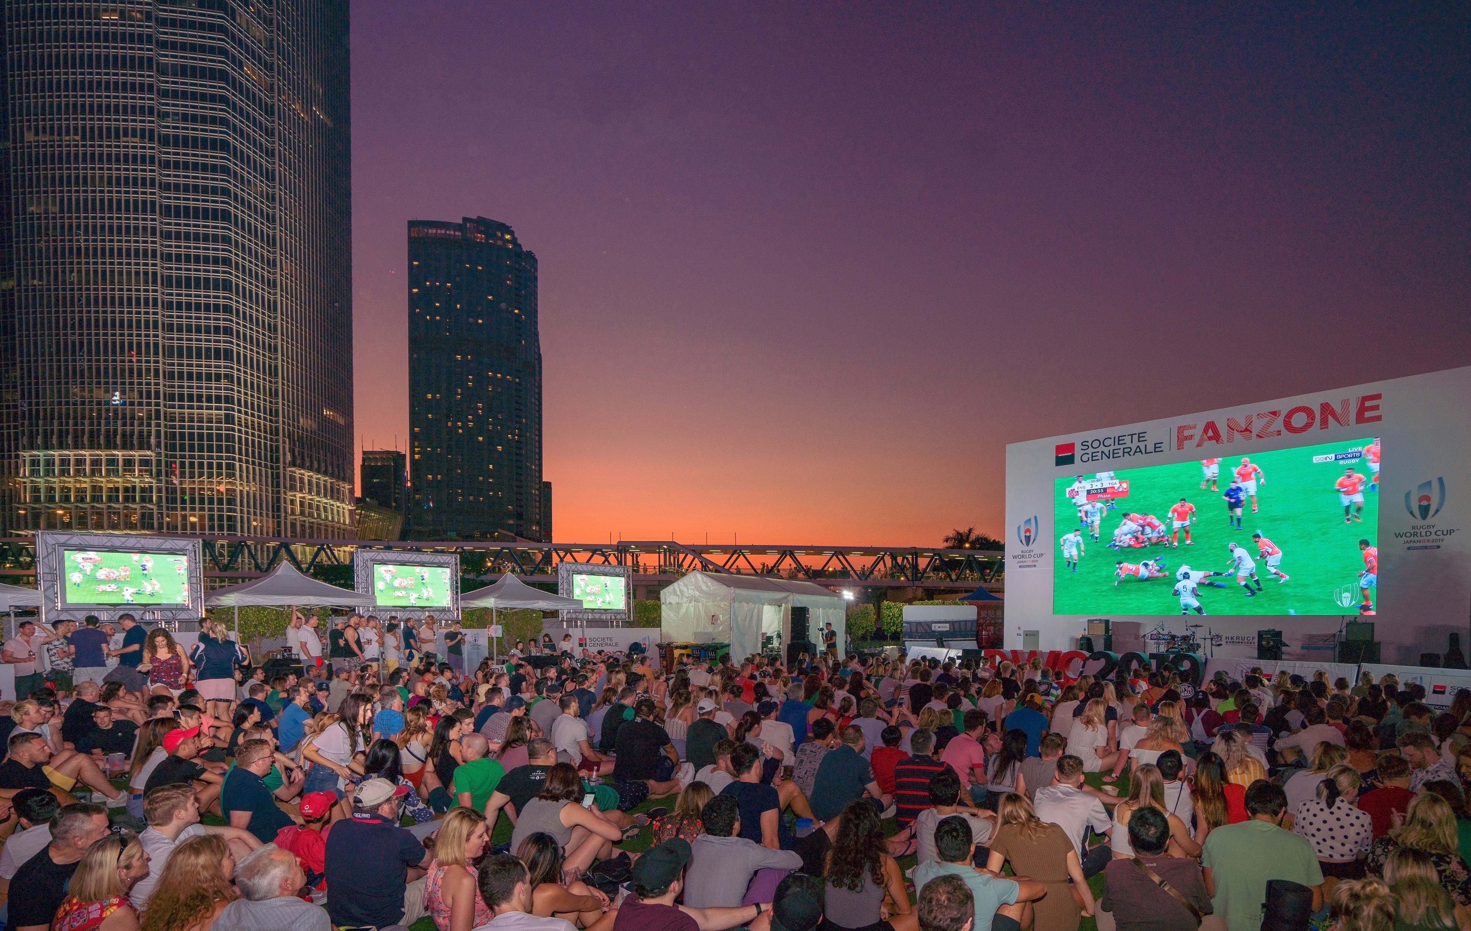
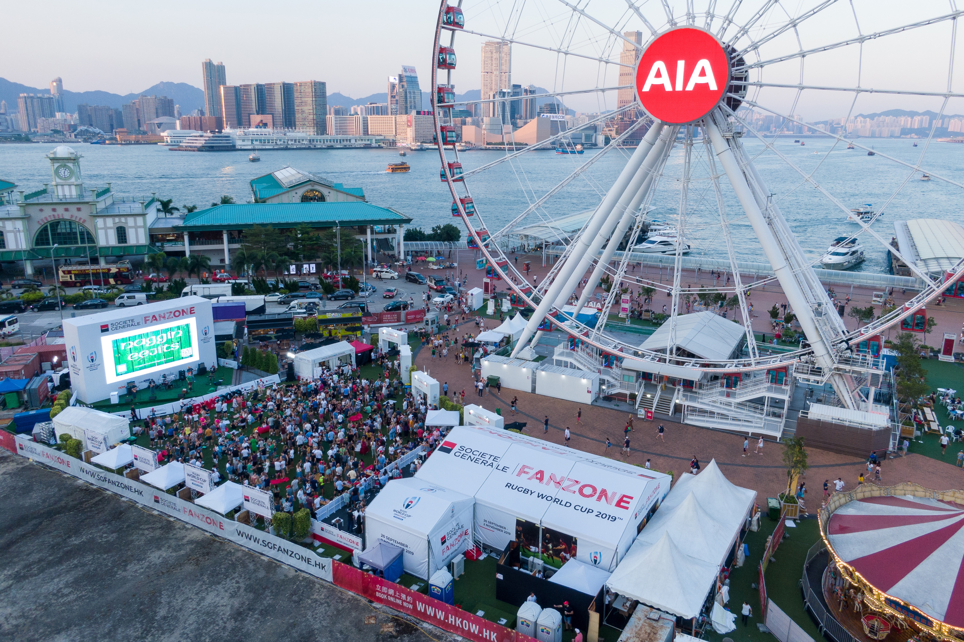
Rugby Union
Event Case Study
Event Type: Rugby World Cup Fan Zone
No. of Days: 44 days
Attendees: 22,000+
Objective
To create the key destination in Hong Kong to watch the Rugby World Cup.
Event
Working collaboratively with the Hong Kong Rugby Union, we successfully organised and operated Hong Kong’s only outdoor Rugby Fan Zone. With attendance of 1,100+ guests on prime games, we gave the Hong Kong community the greatest outdoor viewing experience for the Rugby World Cup.

Slide 11
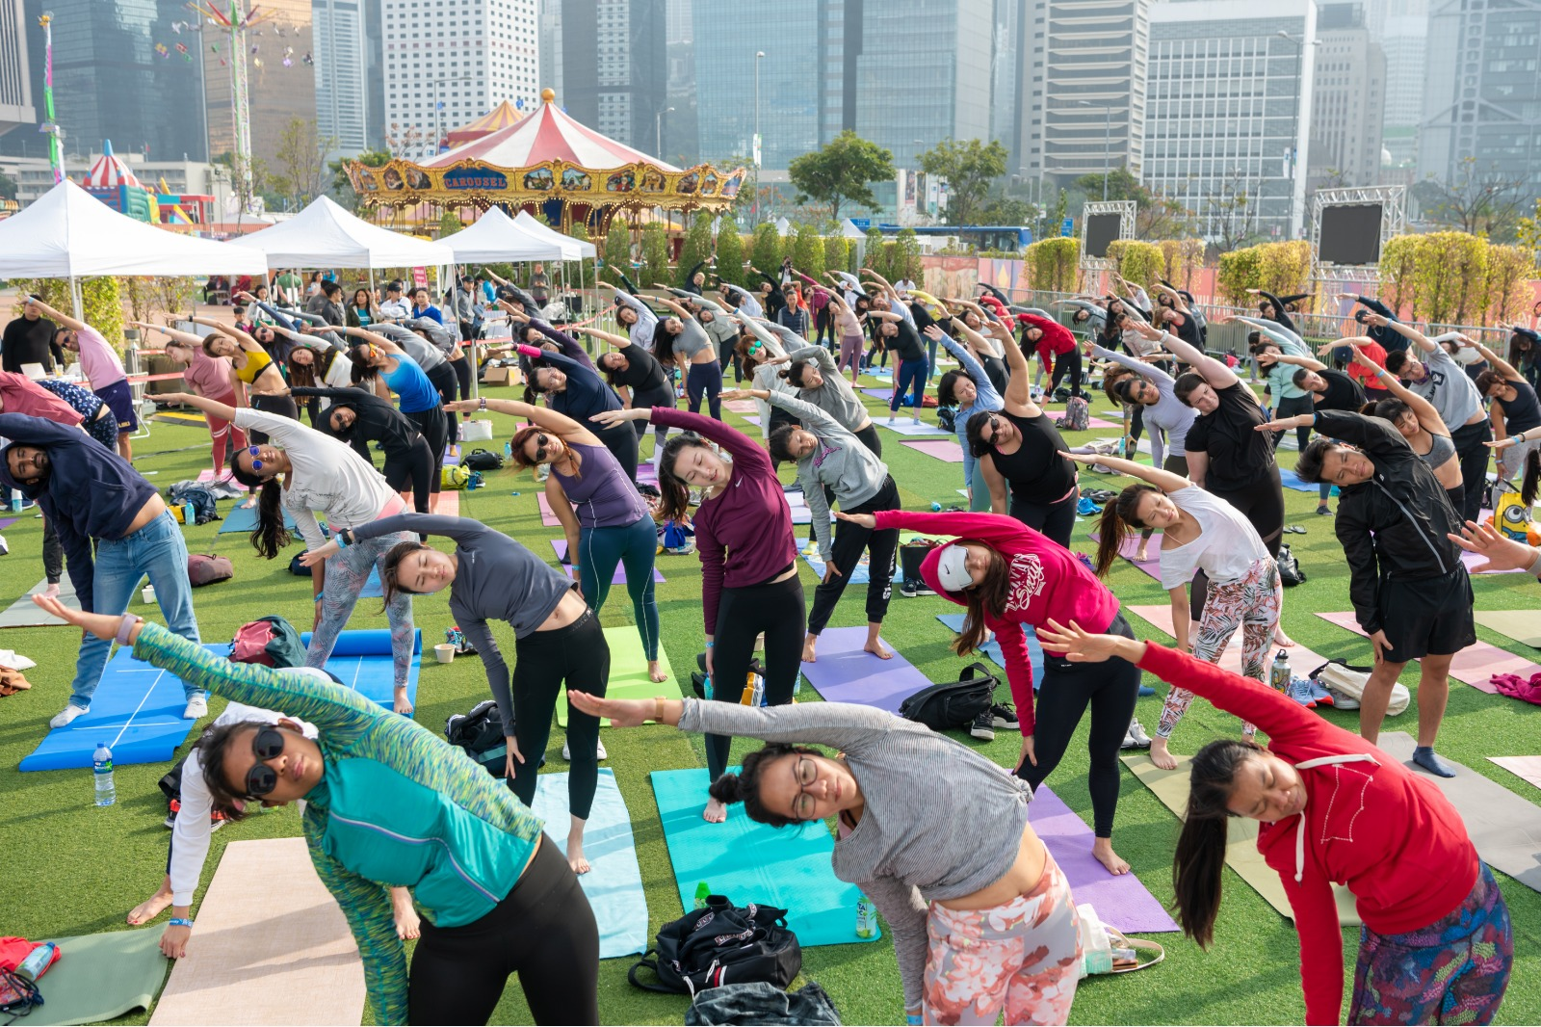
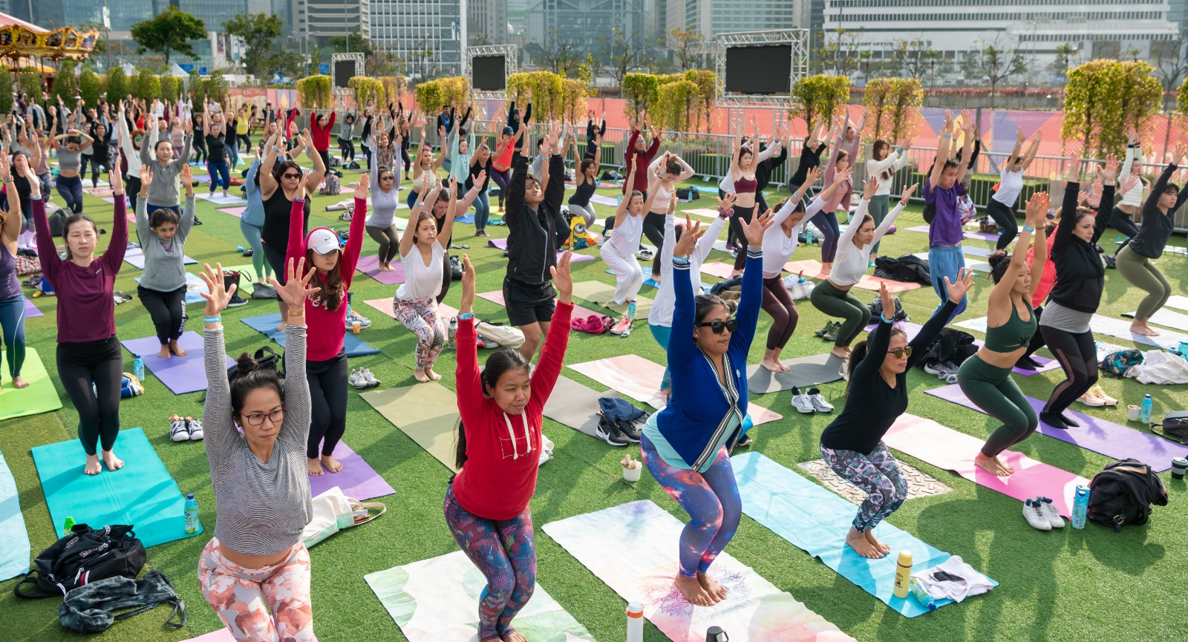
Hong Kong Living
Event Case Study
Event Type: Health and wellness event
No. of Days: 1 day
Attendees: 220+
Objective
To celebrate health and fitness in Hong Kong and to promote the Hong Kong Living brand.
Event
A full day of sports, yoga and dance programming and an outdoor market offering foods, goods and services that promote a healthy lifestyle.

Slide 12
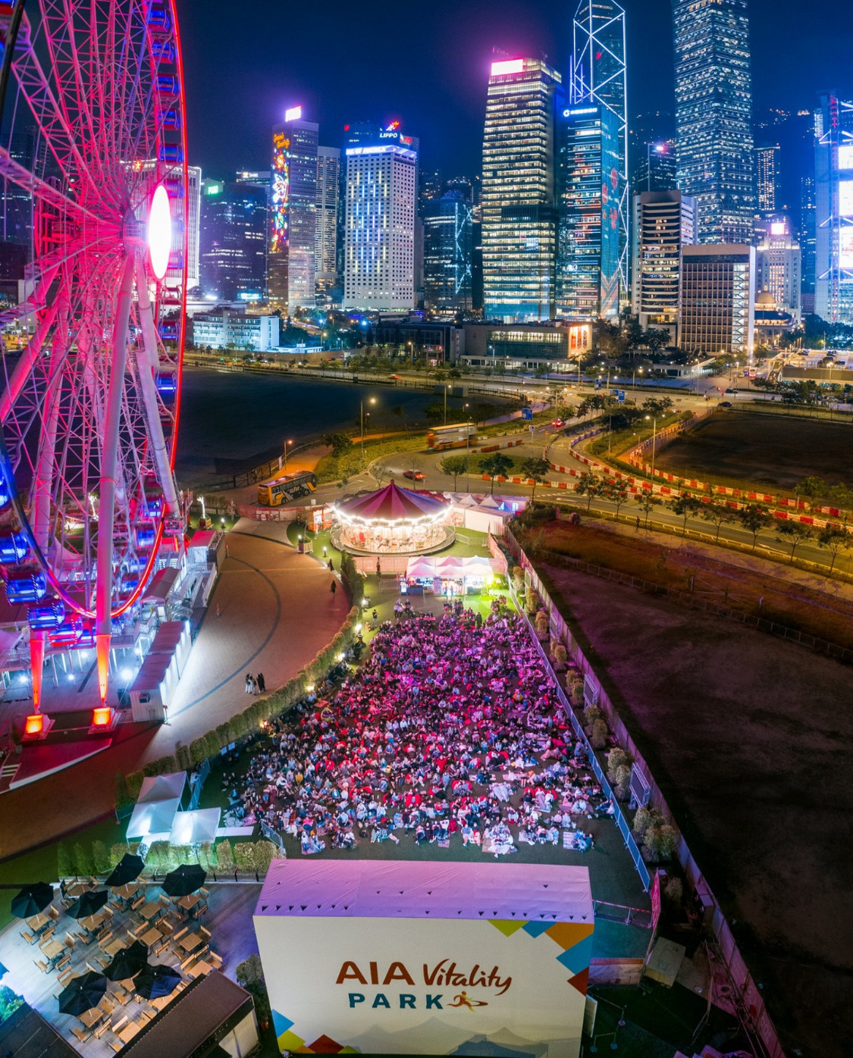
Moonlit Movies
Event Case Study
Event Type: Outdoor cinema
No. of Days: 15 days
Attendees: 3,000+
Objective
To give the Hong Kong community an outdoor movie-viewing experience and to get into the festive spirit in the lead up to Christmas.
Event
Moonlit Movies featured 20 movie showings over 15 days – either afternoon or evening (or both) showings including Christmas classics, family blockbusters and romantic comedies. To compliment the movies there was an eclectic mix of F&B options available; including popcorn, candy floss, mulled wine, hot dogs and more.
Guests were invited to set up picnic blankets, rent bean bags, grab some snacks and enjoy the movies on the huge LED screen.

Slide 13
For more information please contact: enquiries@hkow.hk
www. hkow.hk

